Slide 1

Safeguards Rule Training

Slide 2
Safeguards Rule 2022
The Federal Trade Commission (FTC) has finalized changes to the Standards for Safeguarding Customer Information rule (Safeguards Rule) under the Gramm-Leach-Bliley Act (GLBA). The updated Safeguards Rule amends the FTC’s 2003 Safeguards Rule and requires financial institutions (which includes Dealers) to strengthen their data security safeguards to protect customer financial information. Compliance with the updated Safeguards Rule is required by December 9, 2022. The updated Safeguards Rule now includes specific criteria for what safeguards financial institutions must implement as part of their information security program. Previously, similar rules provided only general guidance and not specific requirements.

Slide 3
Original Rule Link
Provide to customers when asked:
For text of the FTC Safeguards Rule with the FTC’s commentary visit:
https://www.federalregister.gov/documents/2021/12/09/2021-25736/standards-for-safeguarding-customer-information

Slide 4
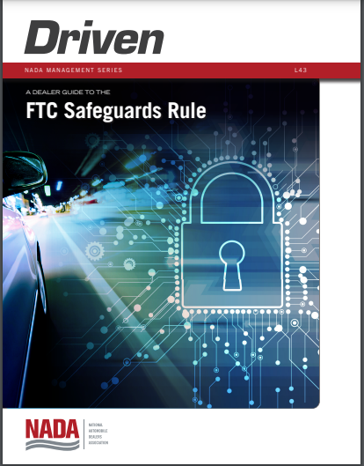
NADA Guide to the FTC Safeguards Rule
Discusses assessments and best practices
Link to document on our website:
https://www.700credit.com/lms-training/

Slide 5

Similarities to Current Programs
Dealerships Should Have in Place
Things you will hear today that are currently requirements for Red Flag, Risk Based Pricing and Adverse Action that you should already have in place.
  Defined Compliance Officer
  Reporting components
  Audit program
  Training Component

Slide 6

Requirements Summary
Dealers need to implement the following items (effective 12.9.22):
  Authenticate, limit, and monitor access
  Identifying and managing data, personnel, devices, systems, and facilities
  Encryption
  Multi-factor authentication (MFA)
  Secure information disposal within 2 years
    Unless needed for legitimate business reasons
  Periodically review data/document retention policy
  Change management procedures

Slide 7

Qualified Individual
Designate “Qualified individual” to implement & enforce (effective 12.9.22)
  If QI is a third-party, “designate a senior member of your personnel responsible for direction and oversight of the Qualified Individual” (effective 12.9.22)

Slide 8

Written Information Security Program
Dealers must establish a comprehensive written information security program, including designating a qualified individual for overseeing and implementing the program

Slide 9

Continuous Monitoring / Penetration & Vulnerability Testing
Continuous monitoring, or penetration testing (at least annually) and vulnerability assessments/scans (at least every 6 months) (effective 12.9.22)
  Penetration testing means a test methodology in which assessors attempt to circumvent or defeat the security features of an information system by attempting penetration of databases or controls from outside or inside your information systems
    “Assessor” has been previously defined by the FTC as an independent third party professional holding certifications who uses standards and procedures generally accepted in the profession. See, In re LightYear Dealer Technologies, LLC, d/b/a DealerBuilt, FTC File No. 1723051; In re James V. Grago, Jr. d/b/a ClixSense.com.
  FTC has acknowledged, “biannual vulnerability testing may not be sufficient to detect new threats”

Slide 10

Encryption of Customer Information
Encrypt all customer information, both in transit over external networks and at rest.

Slide 11
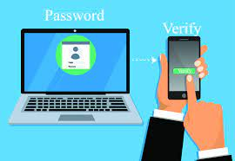
Multi-Factor Authentication
Implement multifactor authentication for individuals accessing networks that contain customer information. Authentication measures may include (1) knowledge factors (a password); (2) possession factors (a token); or (3) inherence factors (biometric characteristics).

Slide 12

Service Provider Oversight
Systems Inventory
Vender Survey
Require vendors with access to customer information to agree to safeguard information
Periodically assess vendors
Take reasonable steps to select and retain third-party service providers that maintain appropriate safeguards for customer information and periodically assess service providers to ensure compliance

Slide 13

NADA/NIADA Comment Responses
Dealers do not have to follow third-party QI recommendations, but must find alternative safeguards that are adequate and functional (Footnote 199)
If a vendor’s system does not meet the encryption requirements, the QI must work with the vendor to develop compensating controls or cease doing business with the vendor (Footnote 172)
Anonymized information that is no longer linkable to a customer will not count towards the 5000 total (Footnote 332)
  However, retaining only “name, phone number, address, and VIN of the vehicle they own,” would count towards the 5000 total (Footnote 332)

Slide 14

Risk Assessments
Undertake risk assessments and implement safeguards to address identified risks. Assessments must be in writing and include criteria for evaluating and identifying security risks, as well as ways to mitigate or accept those risks. Risk assessments must be performed periodically to reassess the reasonably foreseeable risks to the security of customer information

Slide 15

Incident Response Program
In case of a breach:
Establish a written incident response plan with clear roles, responsibilities, decision-making authority, and communications (effective 12.9.22) add slide

Slide 16

Logging and Disposal of Customer Information
Develop, implement, and maintain procedures for the secure disposal of customer information no later than 2 years after the last date the information was used, unless otherwise required to retain the information longer, and implement policies, procedures and controls designed to monitor and log the activity of unauthorized users and detect unauthorized access, use or tampering with customer information

Slide 17

Training Requirements
Security awareness training for all personnel (effective 12.9.22)
Update the training for employees based upon risk assessments and/or changes in practices and verify that training requirements have been met
Safeguard Training
Training Program with Audit Capabilities

Slide 18

Reports to Board of Directors
The qualified individual must provide written reports at least annually to boards of directors or governing bodies on the financial institution’s information security program. Including information on the overall status of the information security program and the financial institution’s compliance, and material matters related to the information security program (such as risk assessments and recommended updates to the program)

Slide 19
5K Consumer Exemption
The following DO NOT APPLY if you retain information for fewer than 5000 consumers that have sought credit:
  No written risk assessment
  No continuous monitoring, penetration testing, or vulnerability scans
  No written incident response plan
  No annual report to board
The following DO APPLY if you retain information for fewer than 5000 consumers that have sought credit:
  Designation of a Qualified Individual
  Encryption of Customer Information at Rest and in Transit
  Service Provider Oversight
  Multi-factor Authentication
  Additional Training Requirements
  Logging and Disposal of Consumer Information

Slide 20

5K Consumer Exemption
5000
Information for 5000 consumers seeking credit is easily surpassed:
  Credit apps/dead deals (should be maintained for 5 years)
    83.33 credit apps per month = 5000
  Deal jackets (should be maintained for at least 7 years)
  DMS
  CRM
  Emails
  Social media
  Website

Slide 21

Key Next Steps
Educate!
  Someone MUST be familiar with requirements
Collaboration/Build a Team
  Dealership
    Named Leader
    Senior Management
    Named IT Resource
  Inventory Systems with Consumer Data
  Build Survey
  Vendors

Slide 22


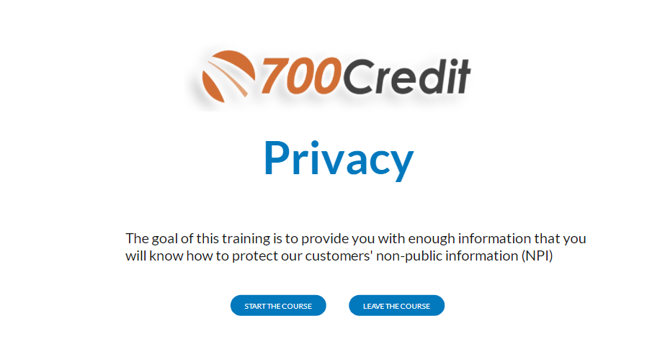
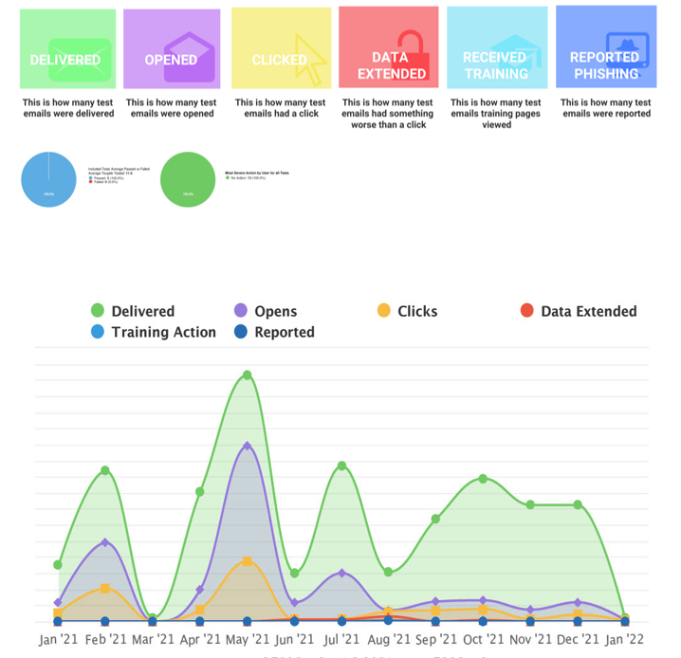
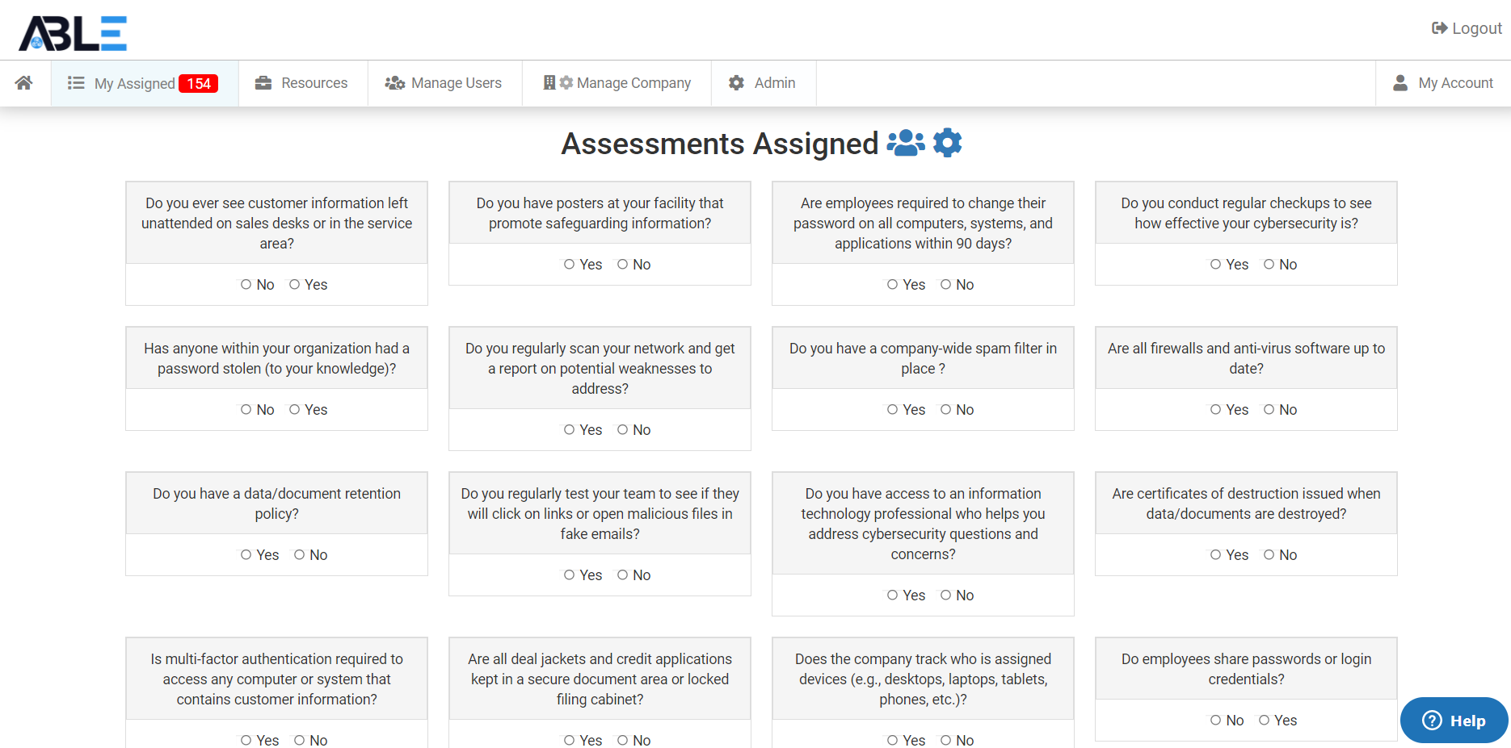
Privacy and Safeguards
Available from 700Credit
  Features Summary:
  Mandatory Security Awareness Training for All Staff:
    Privacy
    Safeguards
    Disposal
    Red Flags
    OFAC
    Paper Flow
    General Cybersecurity Awareness
    Phishing
    PCI
  Simulated phishing attacks
    Remedial training
  Written Risk Assessments
  Vendor Assessments
  Continuous Monitoring of Systems (superior to sporadic penetration testing and vulnerability scans)
  Quarterly ISP Meetings with Qualified Individual/IT/MSSP
  Written Data Retention Policy
  Written Information Security Program (ISP)
  Written Incident Response Plan
  Annual Written Report to the Board

Slide 23

Privacy and Safeguards
Available from 700Credit
Offerings | ComplyNet | Comments
Privacy Course
Safeguards Course
Disposal Course
Red Flags Course
OFAC Course
Paper Flow Course
Information Security Awareness Course
Phishing Course
PCI Course
Simulated Phishing Attacks | ComplyNet performed
Risk Assessments
Vendor Assessments
Quarterly ISP Meetings with Qualified Individual, IT, and/or MSSP
Document/Data Retention Policy | ComplyNet created and custom-tailored to dealer
Information Security Program (ISP) | ComplyNet created and custom-tailored to dealer
Incident Response Plan | ComplyNet created and custom-tailored to dealer
Annual Report Prepared for the Board
Continuous Monitoring of Systems (Far Superior to Penetration Test and Two Vulnerability Scans)
Remediation of Information Systems Issues |  | IT/MSSP
Firewalls, Antivirus, and Other Network Needs |  | IT/MSSP

Slide 24
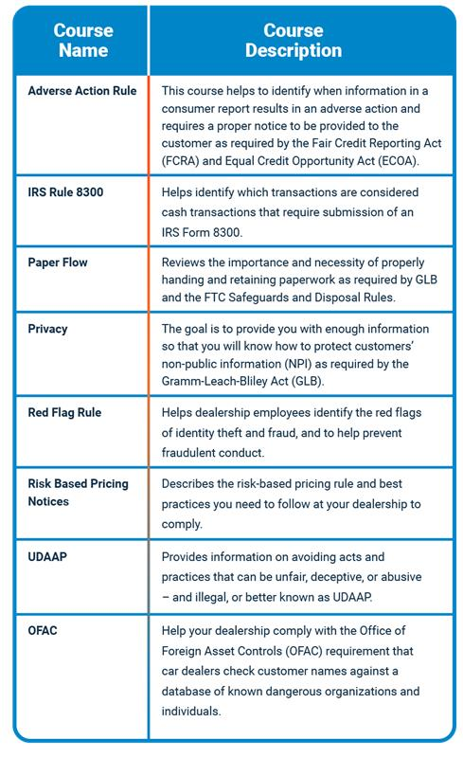
Introduction to the
Learning Management System (LMS)
The Basic Level LMS training program curriculum :
Required for every dealership that utilizes 700Credit to provide their credit reporting needs.
  At least one person from the dealership is required to review the materials within 60 days of the dealership’s enrollment in our new LMS solution.
Meets the guidelines set forth by the three major credit bureaus on the rules and regulations all businesses must follow when accessing consumer credit information.
Takes less than 58 minutes to complete all modules!

Slide 25
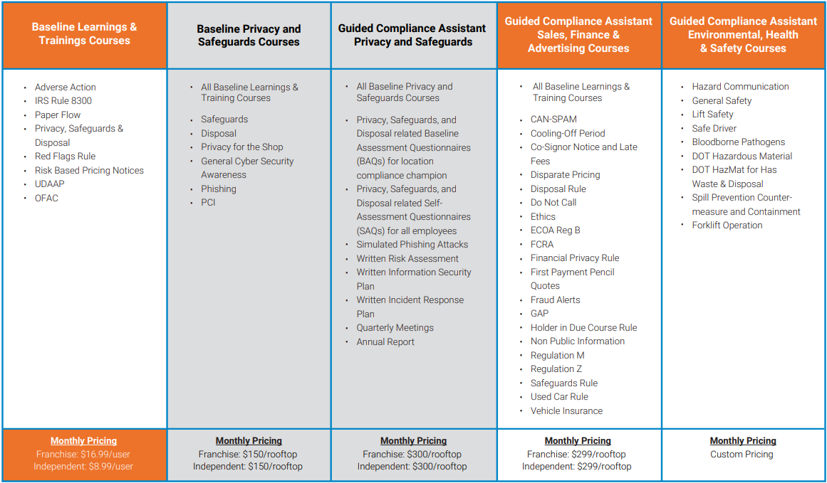
Compliance Training Courses – Available Now

Slide 26

Lead and Opportunity Types
  LMS Required
  LMS Addl License
  LMS GCA FE
  LMS GCA BE
  LMS Safeguards
  LMS Safeguards GCA
  Ancillary Products Requesting
  LMS Safeguards
  LMS Safeguards GCA

Slide 27
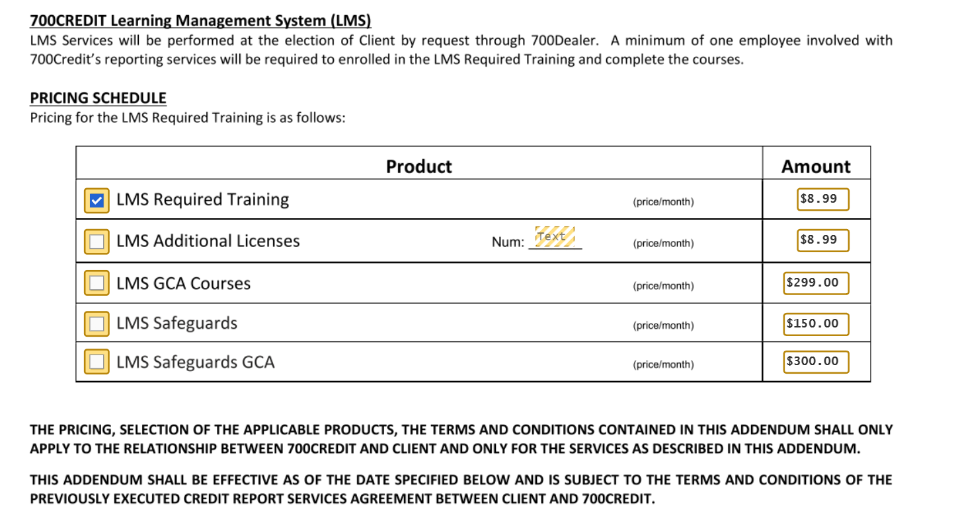

Slide 28
Prequalification Note
We currently use a soft pull on customers and do not generate a hard pull before submitting to our lenders. When we boarded with 700 Credit in our training it was stated unless we have a need for a hard pull this would meet required guidelines. It was also stated that since it is only a soft pull there is no need to complete ID verification or provide a Risk Based Pricing notification.
I was on a call today that this was brought up on and was informed this information is incorrect and based on REG Z all customers who are sent to a lender must have a hard pull completed. Can you clarify?

